Slide 1
Our Use Case: TechWave Solution ltd.

Slide 2
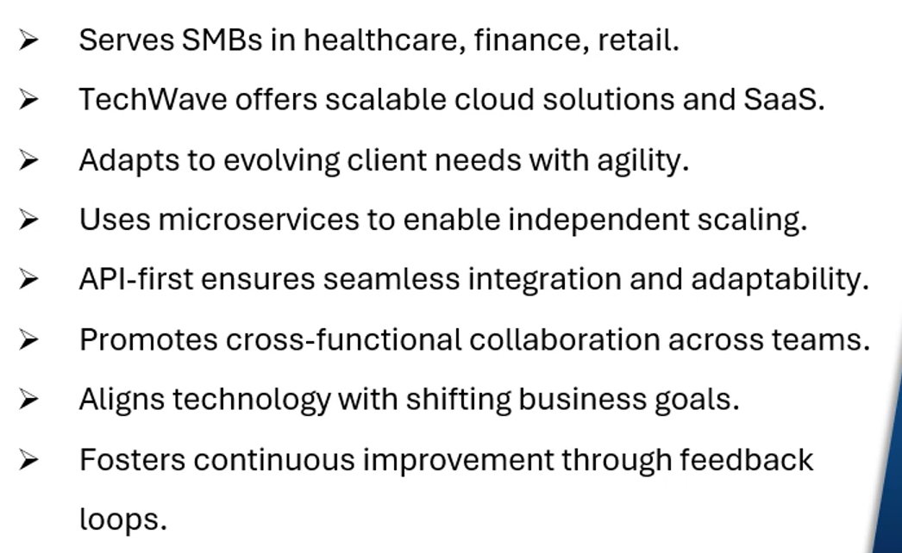
Our Use Case: TechWave Solution ltd.

Slide 3
Thank You

